Slide 1
REBOOT Session – Vue.js

Slide 2
Front End Engineering

Slide 3


Slide 4

Front End Engineering Domains
Web
Mobile
Wearables
Iot
vr/Ar/Mr
Notes:
Multi platform
Android / iOS
Multiple versions of Android and iOS
Multi device
Multiple vendors / OS skin + tools
Smartphone, tablet, phablet
Multiple sizes
Usability
interactie tussen gebruiker en front end
muis? touch?
waar welke data weergeven?
hoe data weergeven?
welke componenten?
lay out, navigatie
Accessibility
alternatieve tekst op afbeeldingen
aria-labels
groter font

Slide 5
Technical aspects of FEE
MODULARITY
UI/UX
QUALITY
STATE
ALM
SECURITY
PERFORMANCE
BACK END CONNECTIVITY
ERROR HANDLING
Notes:
Modularity = ease of maintenance, resuability of code, refactorability, …
Quality = code quality maar ook application quality => automated testing, user testing, debugging, …
UI/UX = usability, navigatie, huisstijl (kleuren, fonts, …), responsiveness, (browser) compatibility
State = user preferences bijhouden, bookmarkability
BE connectivity = API design, API consumption, API call caching
Security = authentication, XSS, CSRF, CSP
Error handling =
form validation, how to display errors, when to validate,
back end validation: how to display and handle business exceptions, offline, server error, failure recovery
Performance = time to display, time to interactive, UI smoothness, amount of data, resource caching
ALM = set up to serve locally, build, build for prod, run code quality checks + tests in CI, build via CI, deploy via CI
Choosing future proof technology is very important => all these requirements need to be kept in mind
=> Overlap met andere domeinen zoals UX/CX, QA, TA, Security, Integration

Slide 6

























































Front End Technologies

Slide 7
JavaScript & TypeScript

Slide 8
JavaScript is the language of the web.
It is built into every modern web browser and is thus available on almost every device.

Slide 9

JavaScript - history
1996
Microsoft introduced Jscript into IE3
2000
Introduction of AJAX
1997
ECMAScript standard was defined
2003
Implementation of ECMAScript 4 was stopped
1995
Mocha was introduced into Netscape Communicator to make the web more dynamic
1999
ECMAScript 3 was released and was supported by major browsers & the baseline target for many libs
1995
2000
https://auth0.com/blog/a-brief-history-of-javascript/
Notes:
1995
Mocha was added to Netscape Communicator, the first popular browser, to make the web more dynamic.
It added animations, interaction and other forms of small automation.
Mocha = a small scripting language that can interact with the DOM. It was not oriented to big-shot developers and people with experience in the software engineering side of things. It targeted designers and scripters instead.
Java, born as Oak, was on the rise. Java applets were announced. But it was too big, too enterprisy to target designers and scripters. Mocha was meant to be the companion for Java. Analogous to C/C++ and Visual Basic on Windows. It was renamed to LiveScript and then to JavaScript (after a deal with Sun) and integrated into Netscape communicator
The object model and functional features of JavaScript, as we know it today, were already present in the first version.
1996
Microsoft answered the introduction of JavaScript with their own version of the scripting language: Jscript. They renamed it to avoid trademark issues
JScript had a different implementation, in particular with regards to DOM functions
1997
ECMA, an industry association formed in 1961, concerned solely with standardization of information and communications systems
For trademark reasons, the name JavaScript couldn’t be used. So they named the standard of JavaScript ECMAScript
Today, JavaScript is just the commercial name for ECMAScript
1999
ES 3, supported by many browsers + baseline target for many browsers was released
It contained the first big changes to the language
Exceptions + try catch block
Regex
Do-while
In and instanceof
Much better error handling
More built in functions for strings and arrays
Formatting for numeric output
2000
AJAX was introduced in the years of ES3
It was not a standard. MS implemented certain extensions to JS for IE5, such as XMLHttpRequest (in the form of an ActiveX control)
Async HTTP requests could be performed against a server. So pages could be updated on-the-fly
2003
Strong differences in the ECMA committee (Mozilla, Adobe, Opera, Microsoft and Yahoo)
Some thought JS needed features to become a stronger language for large-scale application development. They proposed features that were big in scope and in changes.
Others thought that was not the appropriate course for the language
Work on a new version (ES4) was stopped after 4 years.
At the peak of development, ES4 had features such as
Classes
Interfaces
Namespaces
Packages
Optional static type checking
Type definitions
Iterators
Generators
Introspection
Constant bindings
Proper block scoping
Destructuring

Slide 10
JavaScript - history
2015
ECMAScript 6 aka ES 2015
2018
ES 2018
2009
Release of ECMAScript 3.1, renamed to ECMAScript 5
2017
ES 2017
2016
ES 2016
2008
End of ECMAScript 4
Introduction of ActionScript
2005
2015
https://auth0.com/blog/a-brief-history-of-javascript/
Notes:
2008
Development of ES4, after almost 8 years of development was stopped. MS had a lot of concerns and wanted to prevent the finalization of ES4
ES 3.1 was the next release and had full collaboration of all parties. It contained syntactic extensions but no big changes. The project name was Harmony.
ActionScript was released by Adobe. It was based on an early draft of ES4. They open sourced their engine in hopes of speeding ES4 adoption.
2009
ES 3.1 is ready but to avoid confusion, it has ben renamed to ES5
ES5 was the compiling target of many transpilers and was supported by all major browsers
Firefox 4 (2012)
Chrome 19 (2012)
Safari 6 (2012)
Opera 12.10 (2012)
Internet Explorer 10 (2012)
ES5 contained the following features
Getters and setters
Trailing comma’s in array and object literals
New Object methods (create, freeze, getOwnPropertyNames)
New Array methods (isArray, indexOf, every, some, map, filter, reduce)
New Date methods (toISOString, now, toJSON)
JSON
Strict mode
2015
ES6 aka ES2015: many browsers support it but there’s still no complete coverage

Slide 11


Transpilers
Convert one language to another
Let you write tomorrow’s JavaScript, today

Slide 12
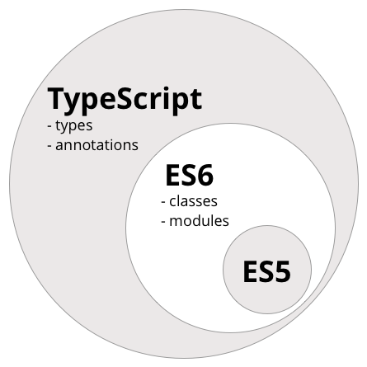
https://www.ng-book.com/2/p/TypeScript/

Slide 13
Dependency Management

Slide 14
ES 2015’s import and export provide modularity to your codebase
But what about external dependencies?

Slide 15


Package managers
Shipped with NodeJs
Versioned independently of NodeJs
Facebooks answer to missing features in NPM
A lot of performance and security improvements under the hood
Offline cache
Deterministic installs using lockfiles
Notes:
NPM is the preferred package manager because it’s the standard and since v5 it has solved the issues that were fixed by yarn (performance, security, deterministic installs)

Slide 16
UX & UI

Slide 17


Slide 18
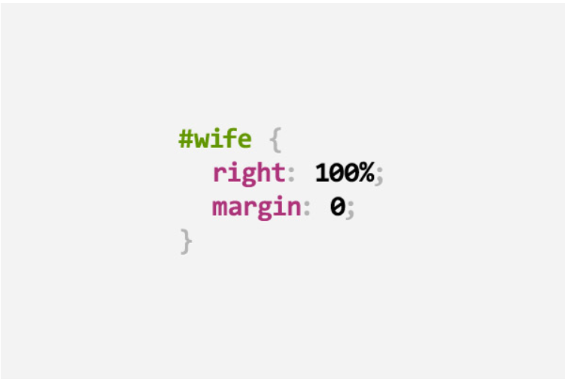
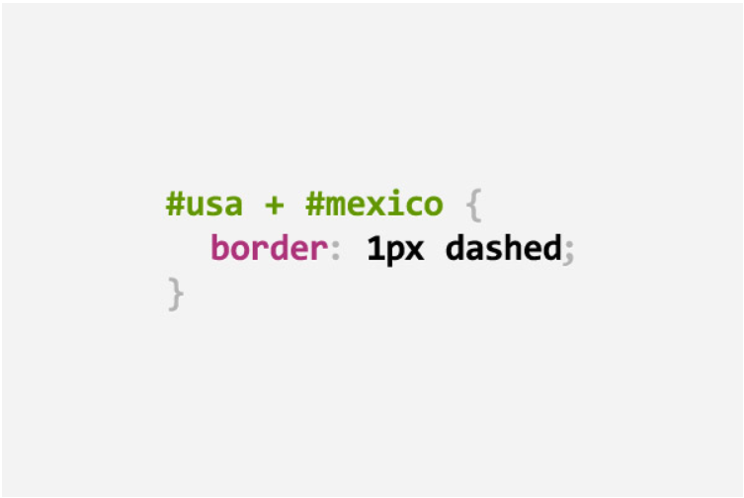
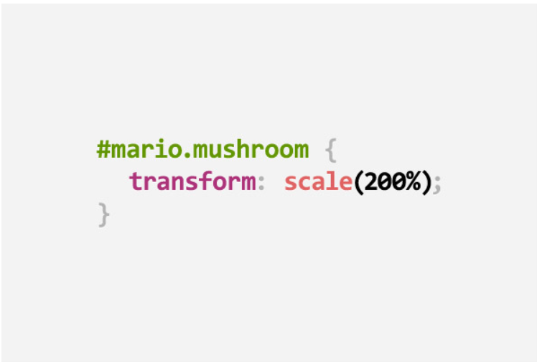
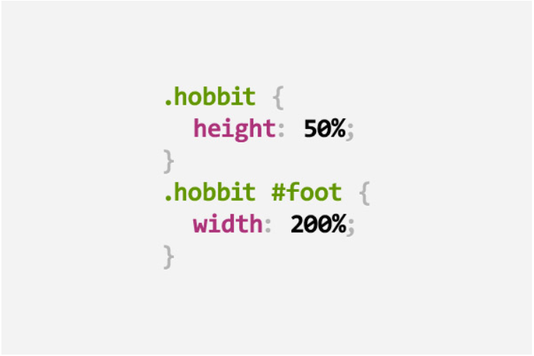
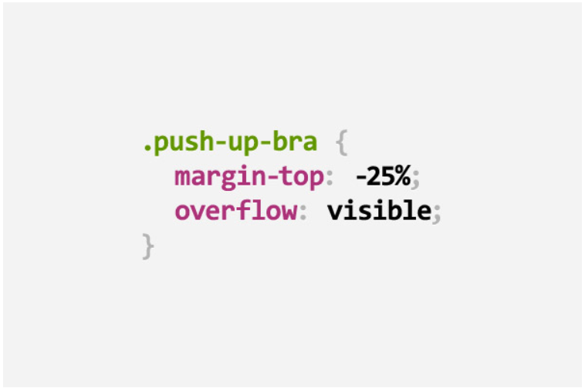
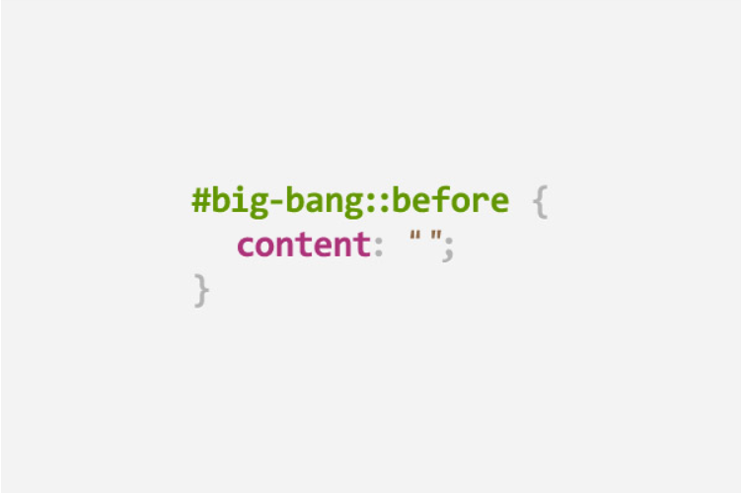
https://digitalsynopsis.com/design/34-css-puns-web-design-funny-jokes/

Slide 19
CSS
CSS is primitive and incomplete
Building a function, reusing a definition or inheritance are hard to achieve
Pre-processors help to achieve writing reusable, maintainable and extensible codes in CSS
They extend CSS with
Variables
Operators
Interpolations
Functions
Mixins

Slide 20


Preprocessors

Slide 21
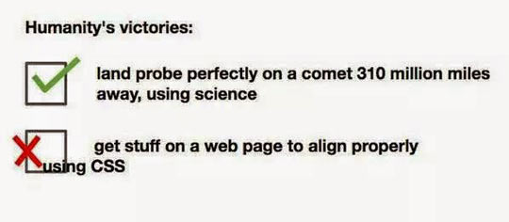
Preprecessors – Missing features
Preprocessors don’t fix layouting issues

Slide 22

CSS – Layout mechanisms

Slide 23
CSS - Flexbox
A more efficient way to
Lay out
Align
Distribute space among items in a container
… even when their size is unknown and/or dynamic
Container
Items

Slide 24
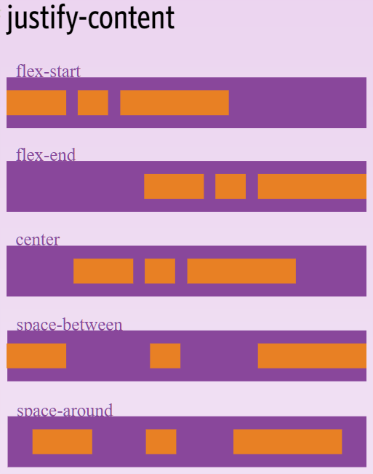
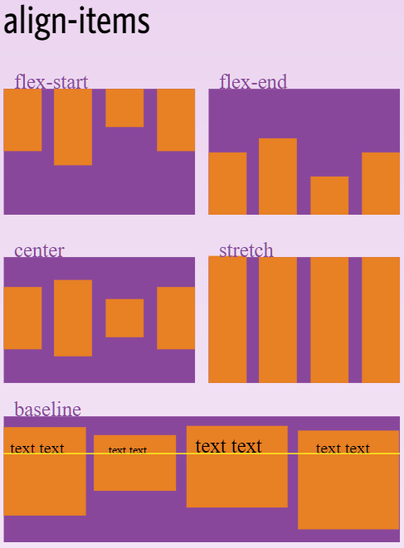
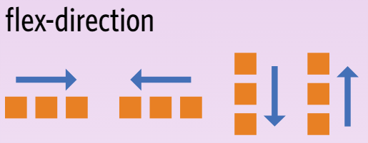
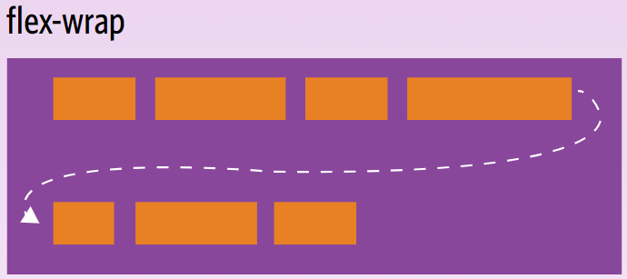
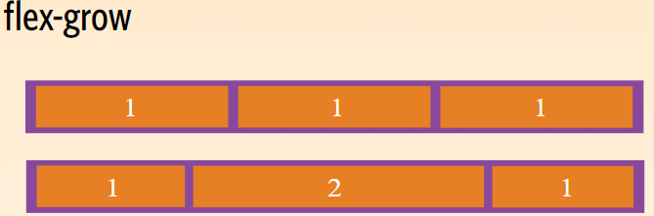
CSS - Flexbox
http://flexboxfroggy.com/
.container {
display: flex;
}

Slide 25
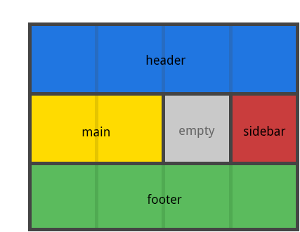
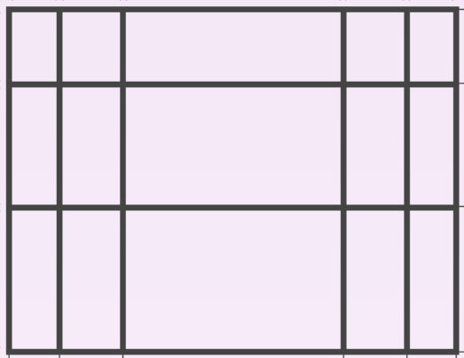
CSS - Grid
2-dimensional system
Can handle rows and columns

Slide 26

CSS – Design & components
A toolkit used to build responsive, mobile first web apps
Provides
Grid layout based on flexbox
Classes for typography, responsive images, and tables
UI components such as buttons, breadcrumbs, cards, dropdowns, form components, modals, navbars, tooltips, …
https://getbootstrap.com/
Notes:
Bootstrap template sites such as https://startbootstrap.com/ or https://bootswatch.com/ , https://wrapbootstrap.com/ are very useful

Slide 27

CSS – Design & components
A visual language that synthesizes the classic principles of good design with the innovation of technology and science.
Provides
Design principles describing how to use shadows, elevation, animations, shapes, icons …
Material design based components exist as well
https://material.io/design/
Notes:
https://mdbootstrap.com/material-design-for-bootstrap/ is interesting if you want material design and are using bootstrap

Slide 28

CSS – Design and components
Notes:
Web fonts: use a font library to use icons in your app that can be easily styled with CSS

Slide 29
Hot and Trending Tech

Slide 30



Slide 31
A Superheroic JavaScript MVW Framework
Google, ° Sept 2016 (AngularJS: Oct 2010)
An Intuitive, Fast and Composable MVVM for
building interactive interfaces
Evan You, ° Feb 2014
A JavaScript library for building user interfaces (V)
Facebook, ° Mar 2013

Slide 33
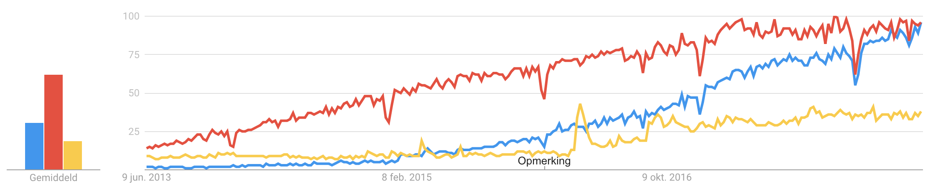
Google Trends

Slide 34
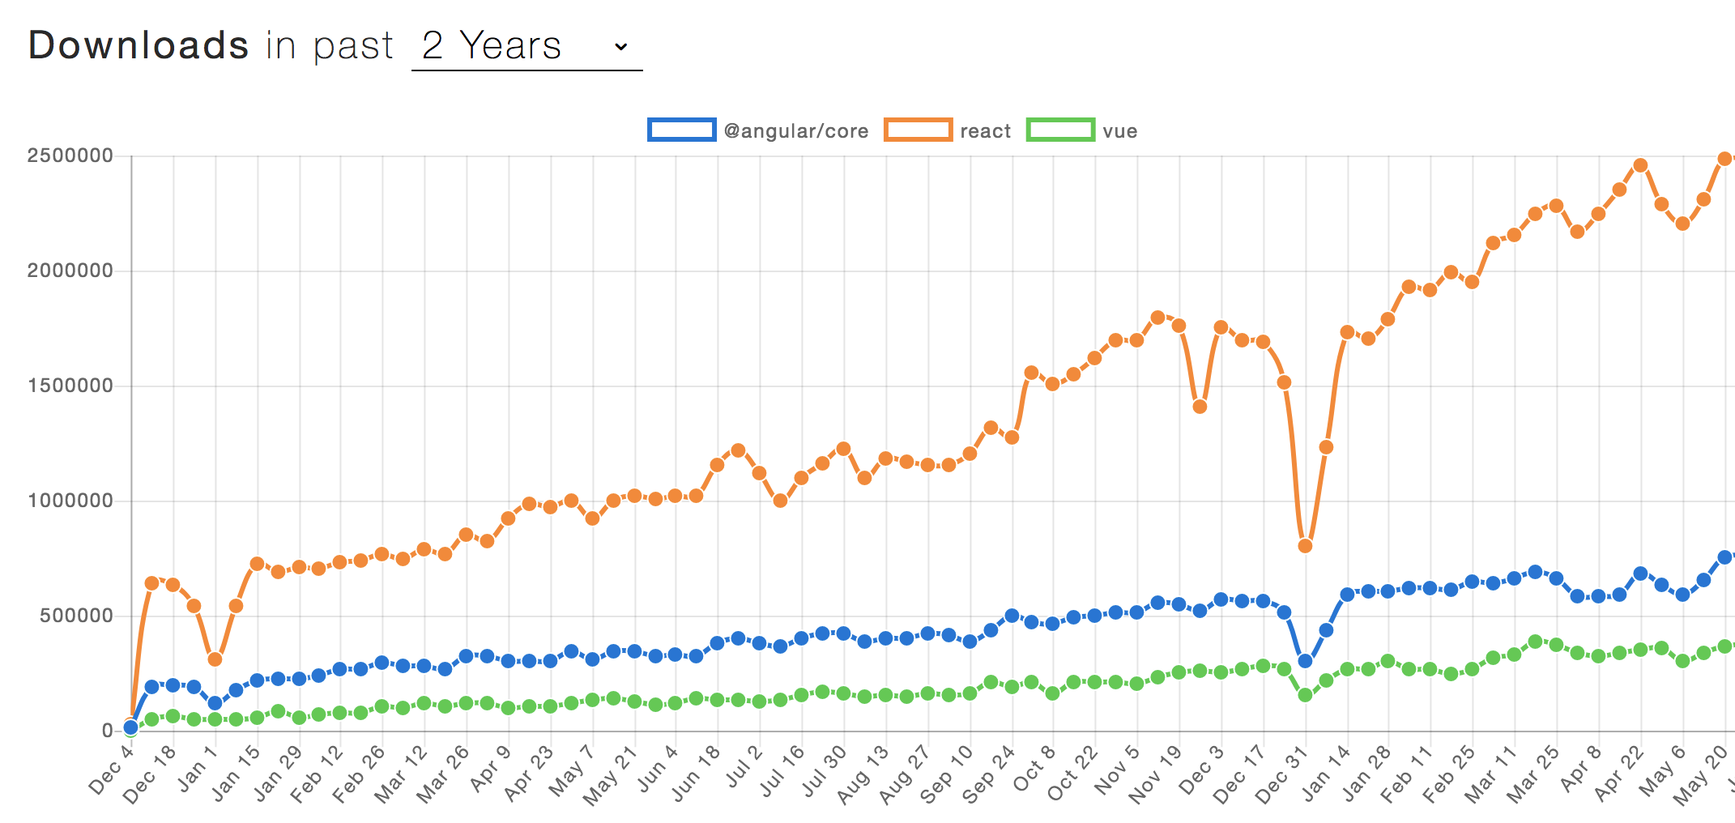
NPM Trends

Slide 35
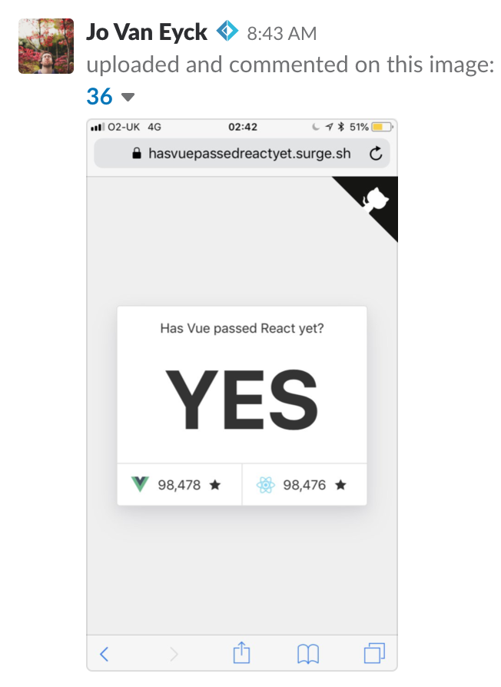
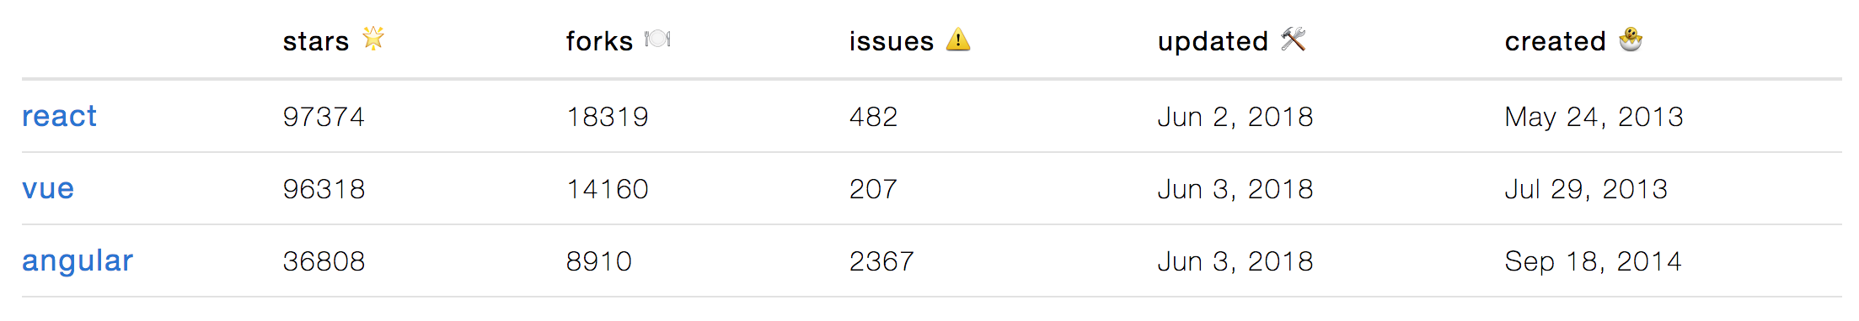
GitHub stars

Slide 36
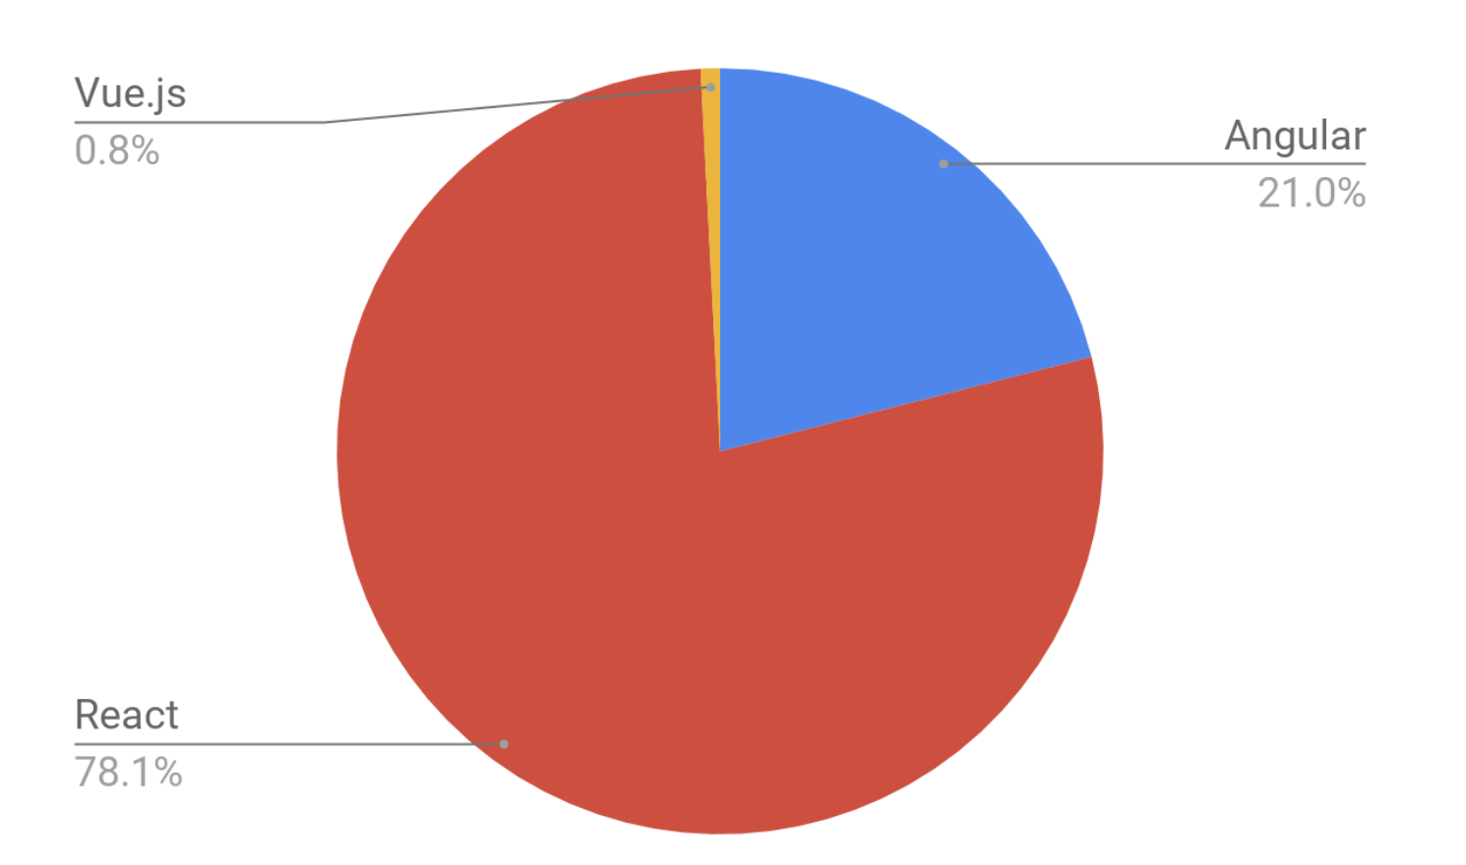
Recruiting

Slide 37
Frameworks vs. libraries
Framework – strong opinions on how to structure application and a lot of
functionality out of the box
Complete solution, ready-to-go (if everything goes right)
Framework – “Vue.js does not make large assumptions about much of anything”
“Vue.js comes with the perfect balance of what it will do for you and what you
need to do yourself.”
Library – Universally flexible view oriented library (“UI as a function”)
With great flexibility comes great responsibility

Slide 38
Components

Slide 39
Component Design
Component
Chunks of HTML and javascript that have a responsibility
Even the application is a component
Represented by a typescript class
Two-way data binding
Pass data through inputs
Child-components notify parent-components through outputs
Communication
Components only communicate with their direct parent, and always in the same direction
Notes:
Verschillende angular frameworks kort aanhalen. Verwijzen naar Angular IO als laatste nieuwe
https://angular.io/docs
‘npm update’ + ‘npm install’?

Slide 40

Benefits of component design
Decrease complexity
Increase maintainability
Single responsibility (SoC)
Reusability
Testability

Slide 41
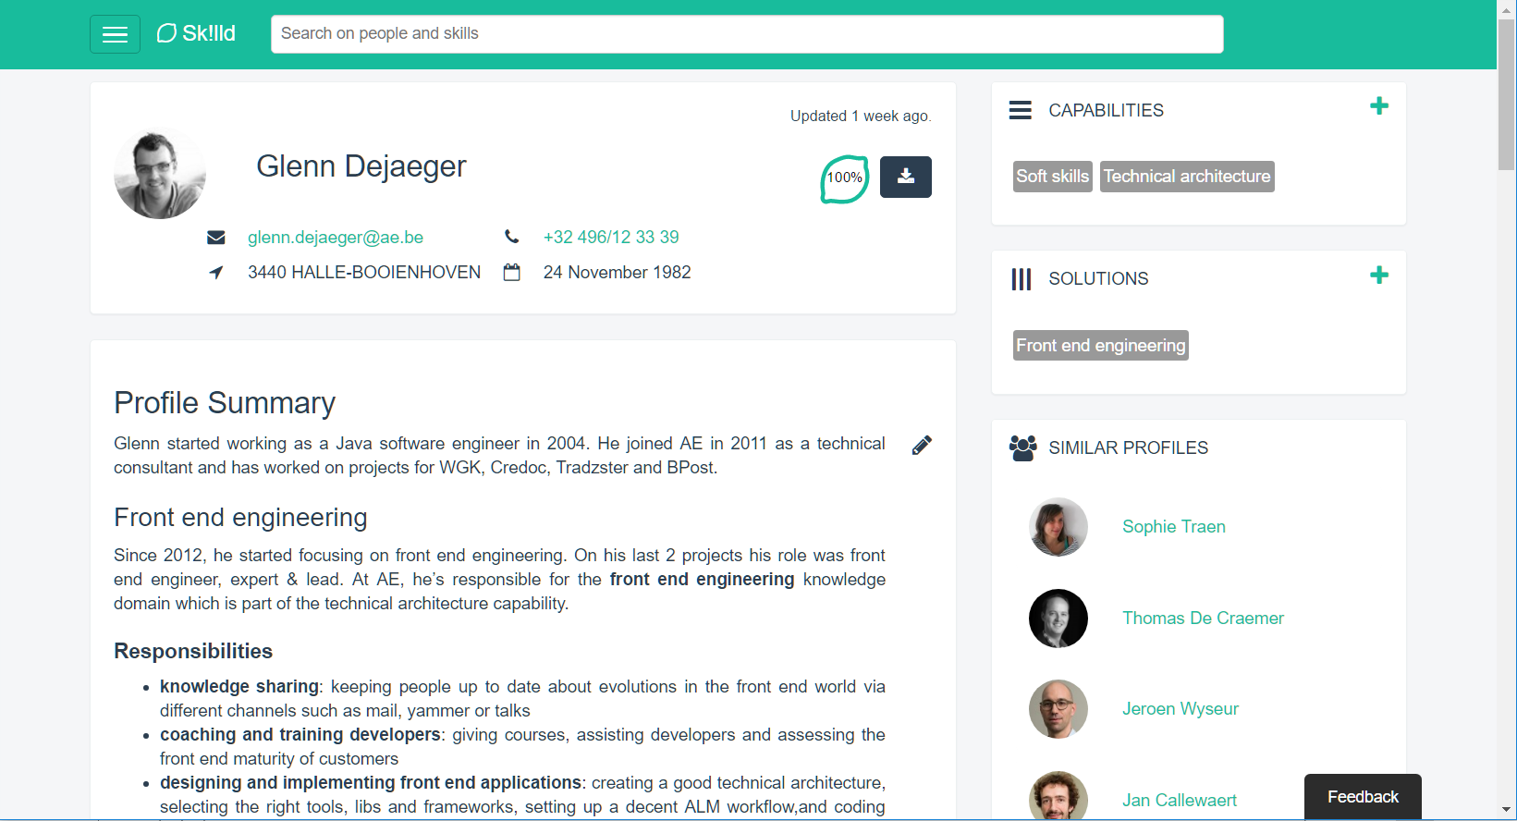

Slide 42
1
2
5
3
4

Slide 43
Templates
Annotated HTML with Angular-specific syntax
*ngIf, *ngFor
Single File Component holds template, logic and styling in different sections
JSX – Mix JS and templates: separating templates and logic is merely a
separation of technologies, not concerns (= component)
Everything is JavaScript and
Angular 2 continues to put ‘JS’ into HTML. React puts ‘HTML’ into JS

Slide 44
Data binding + state management
Components describe the UI at any point in time – UI as function
Two way binding
Cleaner in code, easier to implement
One (two) way binding
One way binding
Harder to understand at first, but better data overview (easier debugging)

Slide 45
Typescript vs. ES6 vs. ES5
TypeScript
ES5/6 (TypeScript/Flow is possible)
ES6 (or TypeScript, if you really want to)

Slide 46
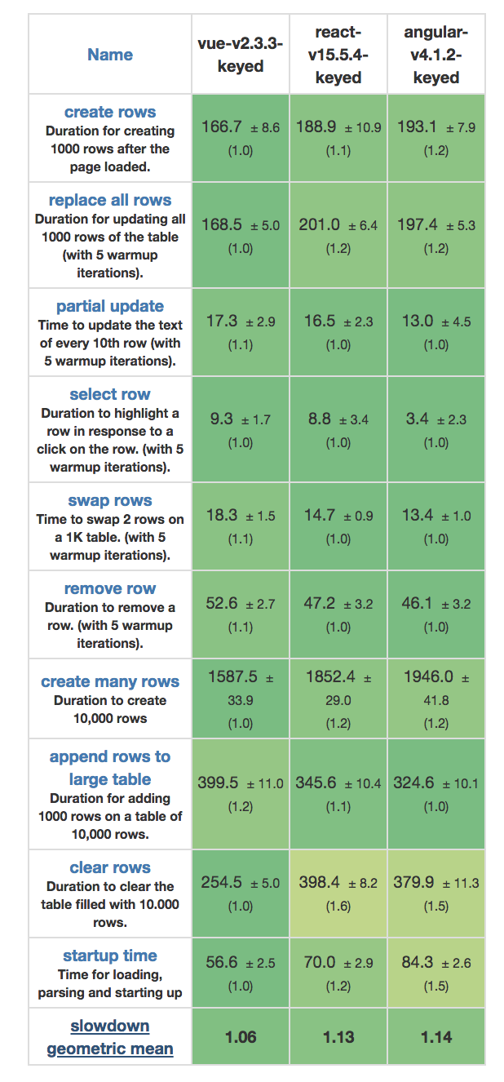
Size + performance
Functionality at a cost: 143K gzipped
23K gzipped*
Virtual DOM
43k gzipped*
Virtual DOM

Slide 47
Testing
Jasmine
Karma
Jest (Mocha)

Slide 48
Learning curve
Steep learning curve, you need to learn a completely new ecosystem
Setup is magical (as in: no idea what’s going on, debugging?) in the beginning,
but they point you to the “right” concepts
Seems to be very easy to start with – looks like VanillaJS but some
new ideas (components, event-driven model, one-way data, …)
A lot of decisions to be made (but a default config exists)

Slide 49
If you work at Google | Angular
If you want the easiest learning curve | Vue.js
If you work at Facebook | React
If you like flexibility | React
If you like choosing among dozens of packages | React
If you love JS & the “everything-is-Javascript-approach” | React
If you like really clean code | Vue.js
If you love TypeScript | Angular
If you want the most lightweight framework | Vue.js
If you need guidance, structure and a helping hand | Angular
If you want separation of concerns in one file | Vue.js
If you work with designers and need clean HTML files | Angular or Vue.js
If you like Vue.js but are afraid of the limited ecosystem | React

Slide 50
Example application - BAC

Slide 51
Demo

Slide 52
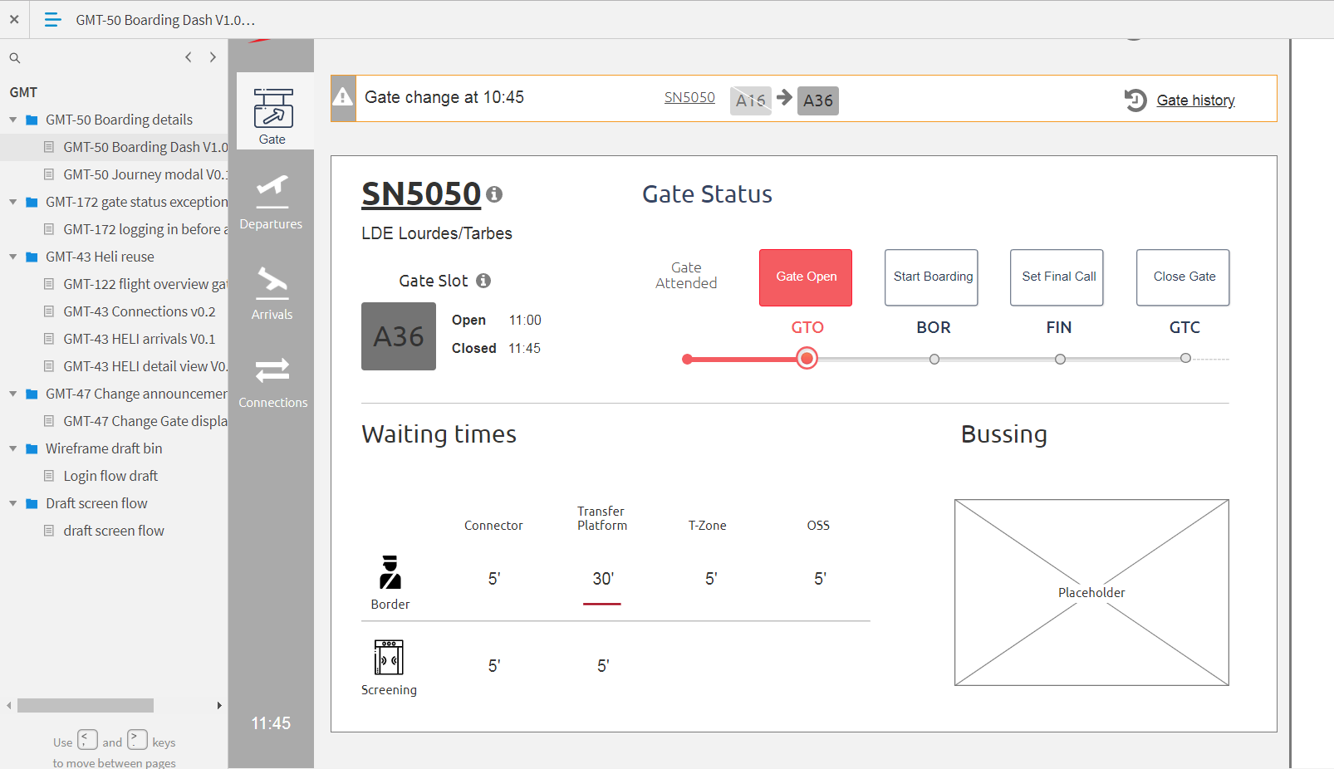
Mockups

Slide 53
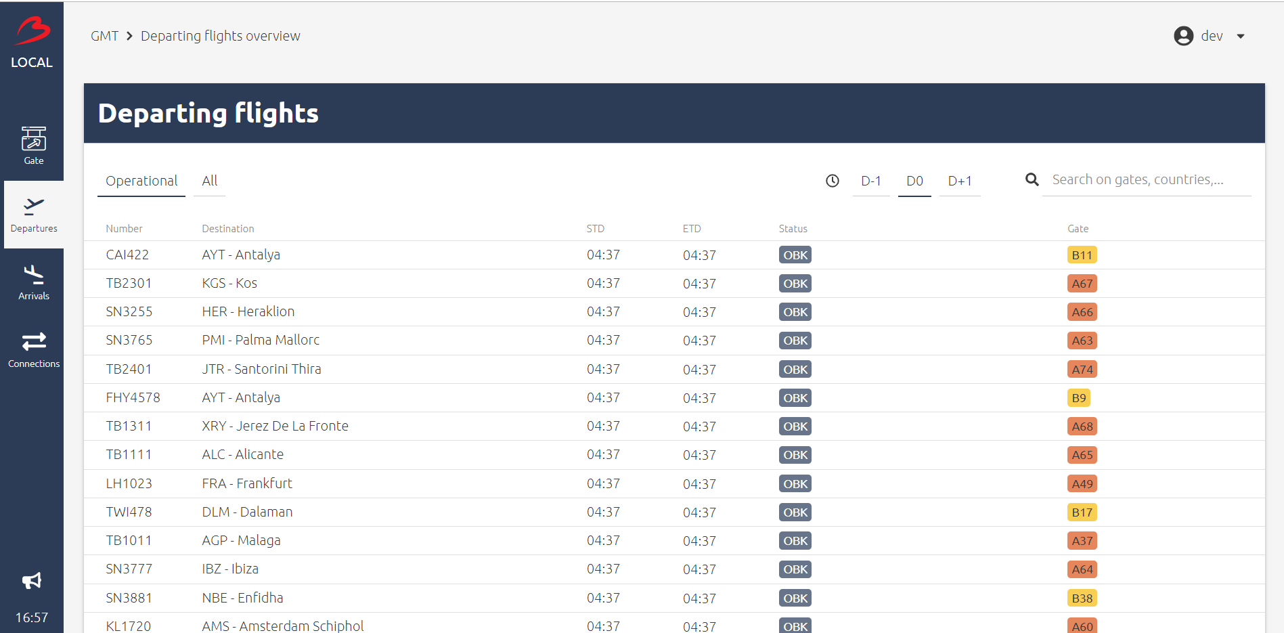
Implementation

Slide 54
VUE.JS

Slide 55
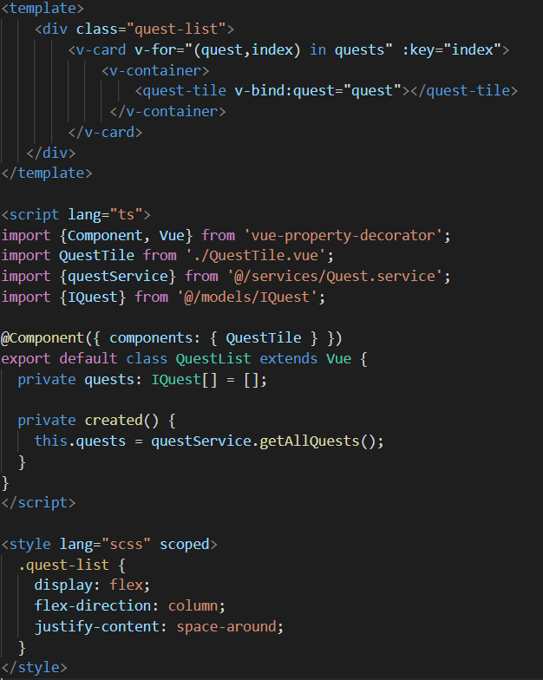
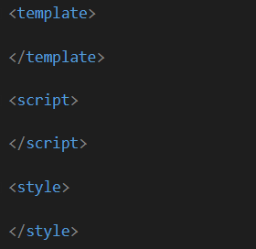

Slide 56
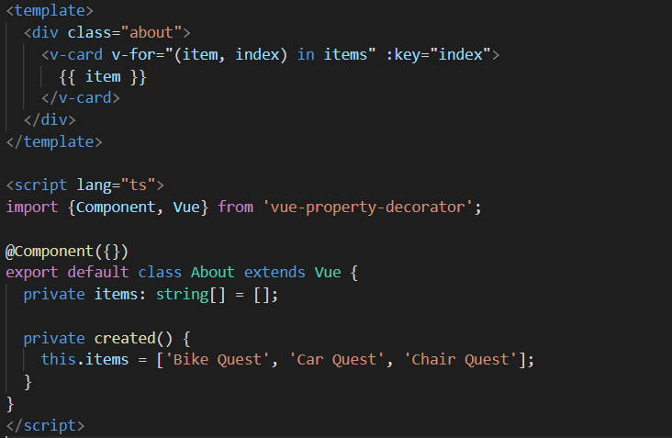

Slide 57
Git
git clone <repo>
git fetch
git checkout <branch>
git add <change>
git commit –m “<message>”

Slide 58
npm install -g @vue-cli
git clone https://github.com/AE-nv/technovate
git checkout bike-quest/exercise-1
npm i
npm run serve
Go to http://localhost:8080

Slide 59
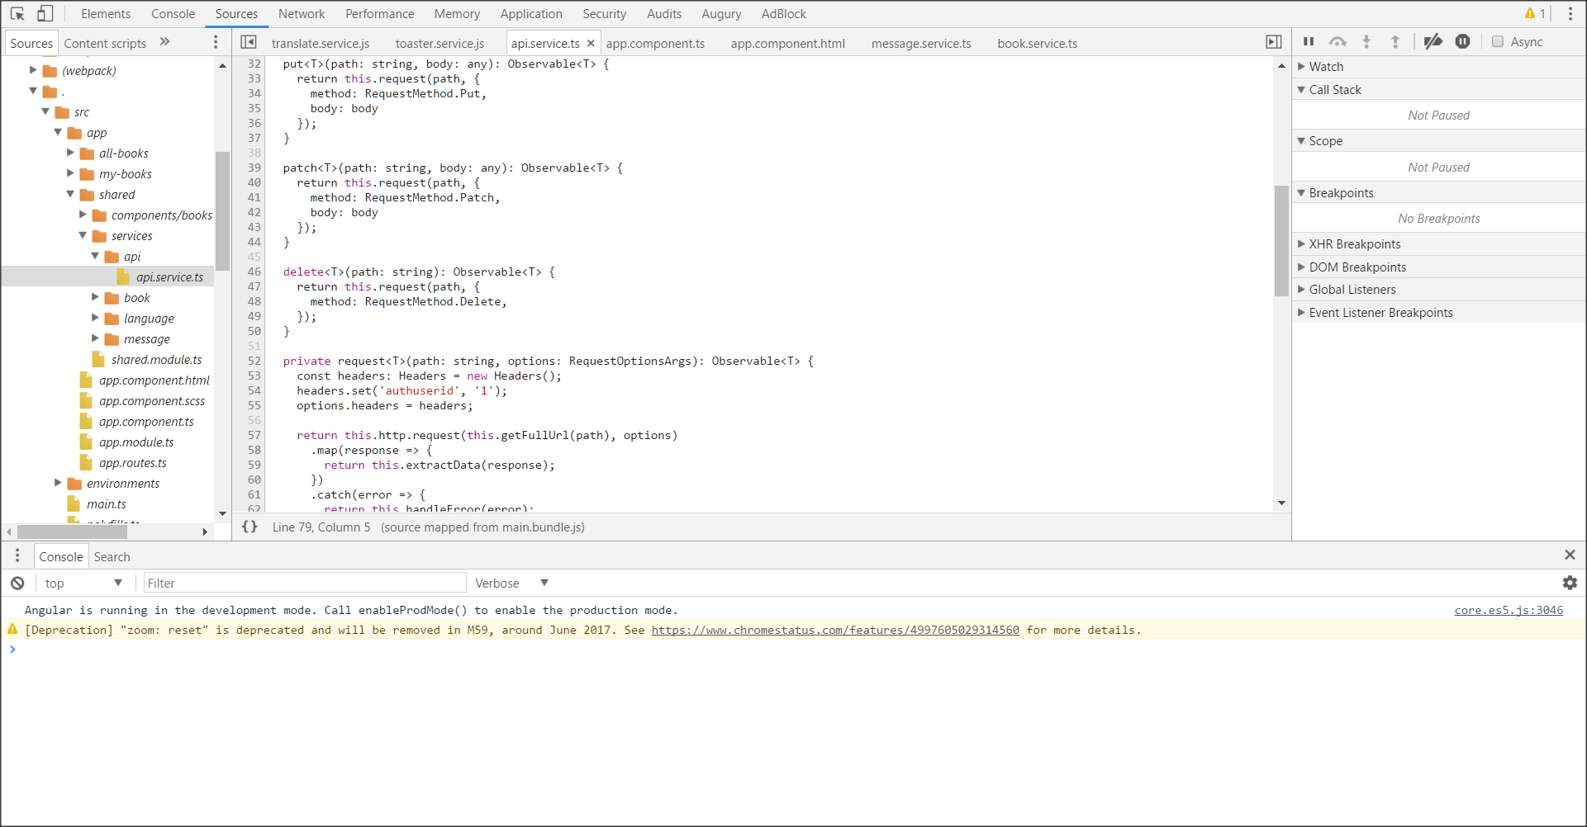
Chrome Dev Tools
https://developer.chrome.com/devtools

Slide 60
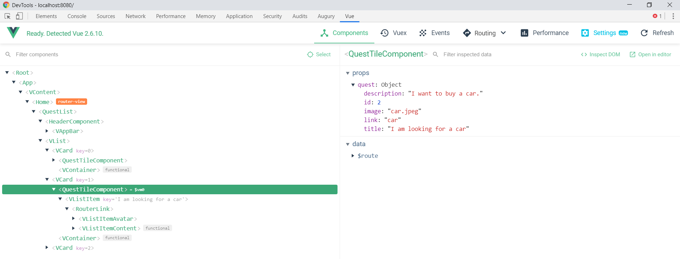
Vue.js devtools

Slide 61
Bike Quest – Exercise 1
Add a v-textarea
Display input in v-card

Slide 62
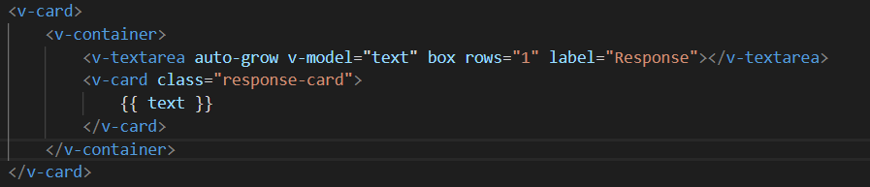
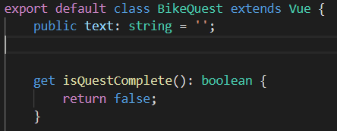
BikeQuest.vue

Slide 63
Bike Quest – Exercise 2
Add a v-btn
Add input to list when button is clicked
Display all responses in list

Slide 64
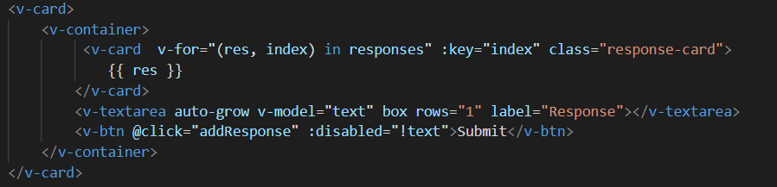
BikeQuest.vue

Slide 65
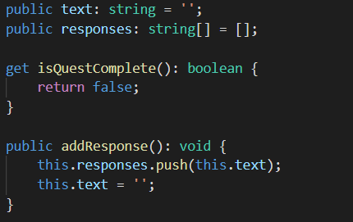
BikeQuest.vue

Slide 66
Bike Quest – Exercise 3
Complete quest when response contains words:
pedals
saddle
wheels

Slide 67
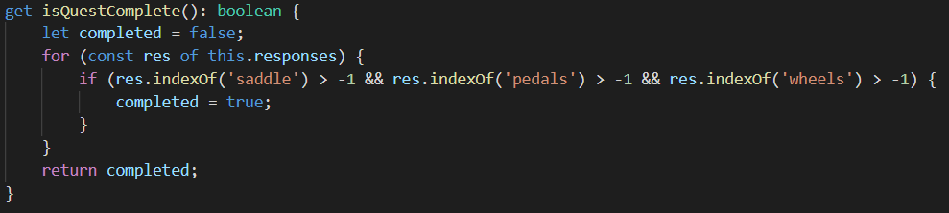
BikeQuest.vue

Slide 68
Bike Quest – Exercise 4
Move text-area to TextAreaBox.vue
Emit input to parent
Add text-area-box to BikeQuest.vue

Slide 69
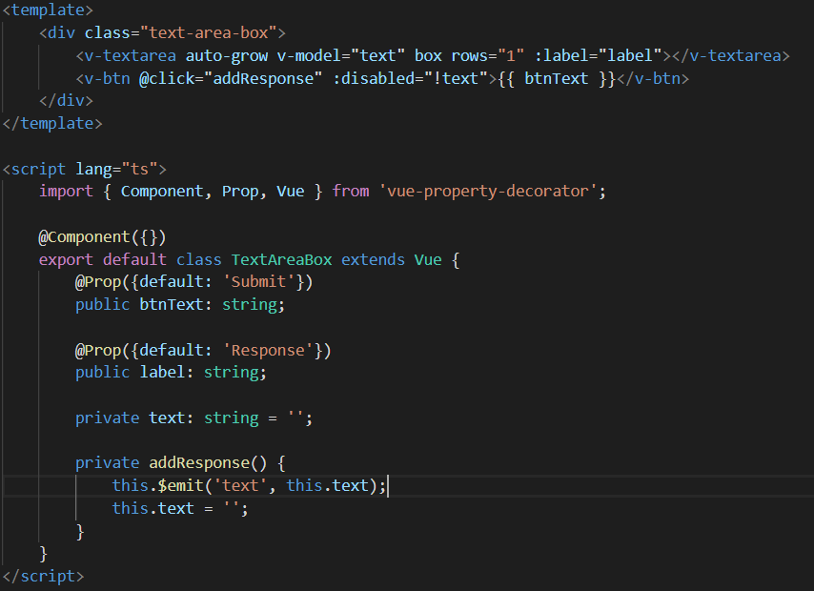
TextAreaBox.vue

Slide 70
TextAreaBox.vue

Slide 71
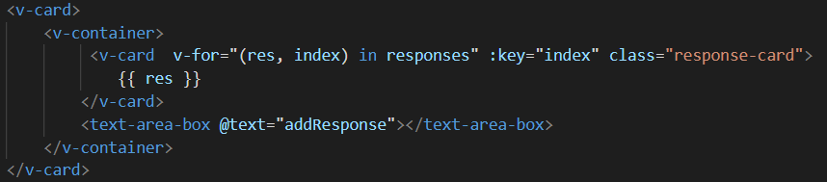
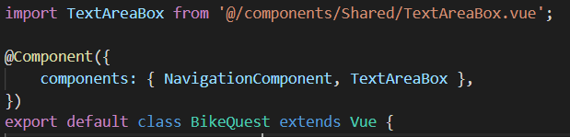
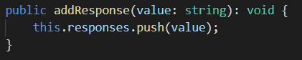
BikeQuest.vue

Slide 72
Car Quest – Exercise 1
Add text-box-area to CarQuest.vue
Call the CarSearchService when button is clicked
Display the result

Slide 73
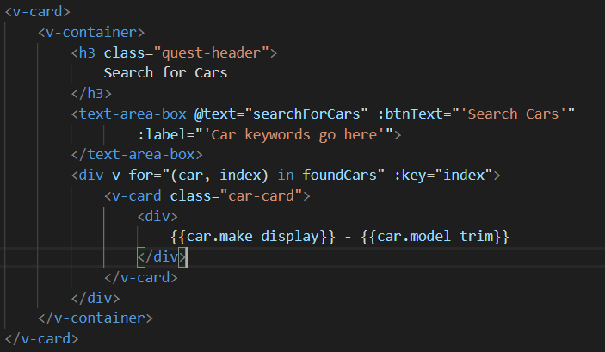
CarQuest.vue

Slide 74
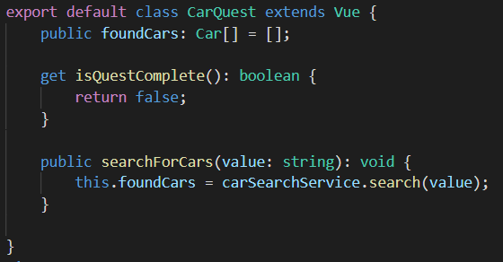
CarQuest.vue

Slide 75
Car Quest – Exercise 2
Implement the search function in the CarSearchService

Slide 76
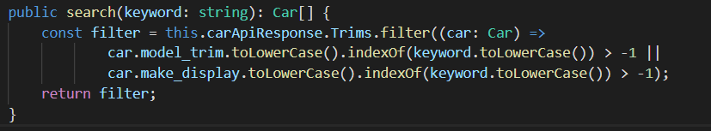
CarSearchService.vue

Slide 77
Car Quest – Exercise 3
Implement functions to recommend and unrecommend cars
Complete quest when recommended cars contains BMW

Slide 78
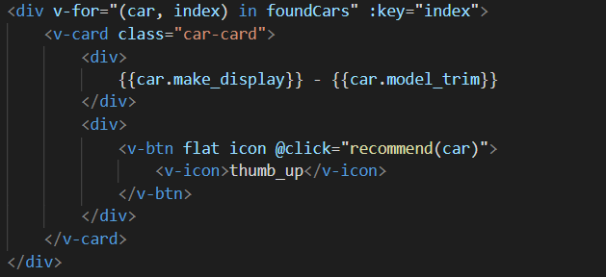
CarQuest.vue

Slide 79
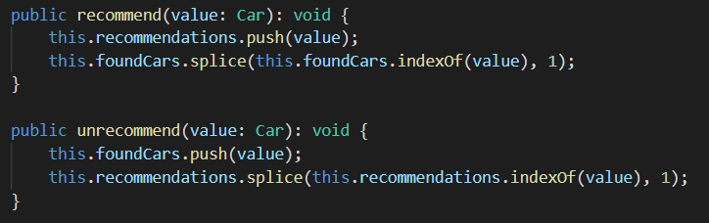
CarQuest.vue

Slide 80
Car Quest – Exercise 4
Replace recommended and result list by CarList component

Slide 81
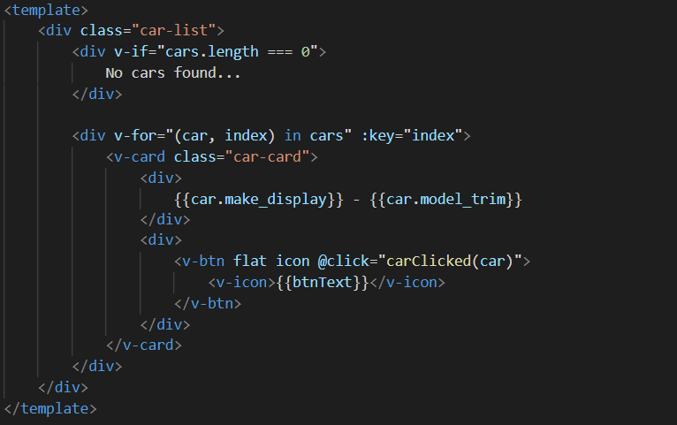
CarList.vue

Slide 82
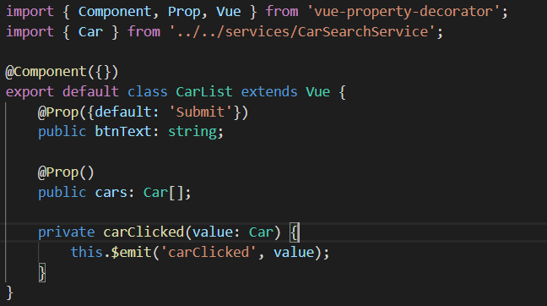
CarList.vue

Slide 83
Chair Quest – Exercise
Add a DropZone component
Show list of files that are uploaded
Call the GoogleVisionApi to determine characteristics
Provide user feedback about loading and result API-call

Slide 85
Confidential and Ownership Clause
The information contained in this presentation is owned by AE NV and confidential. No part of this publication may be copied, reproduced or stored in a system in any form or by any means without the prior written permission of AE NV.
Contact: marketing@ae.be

